Slide 1

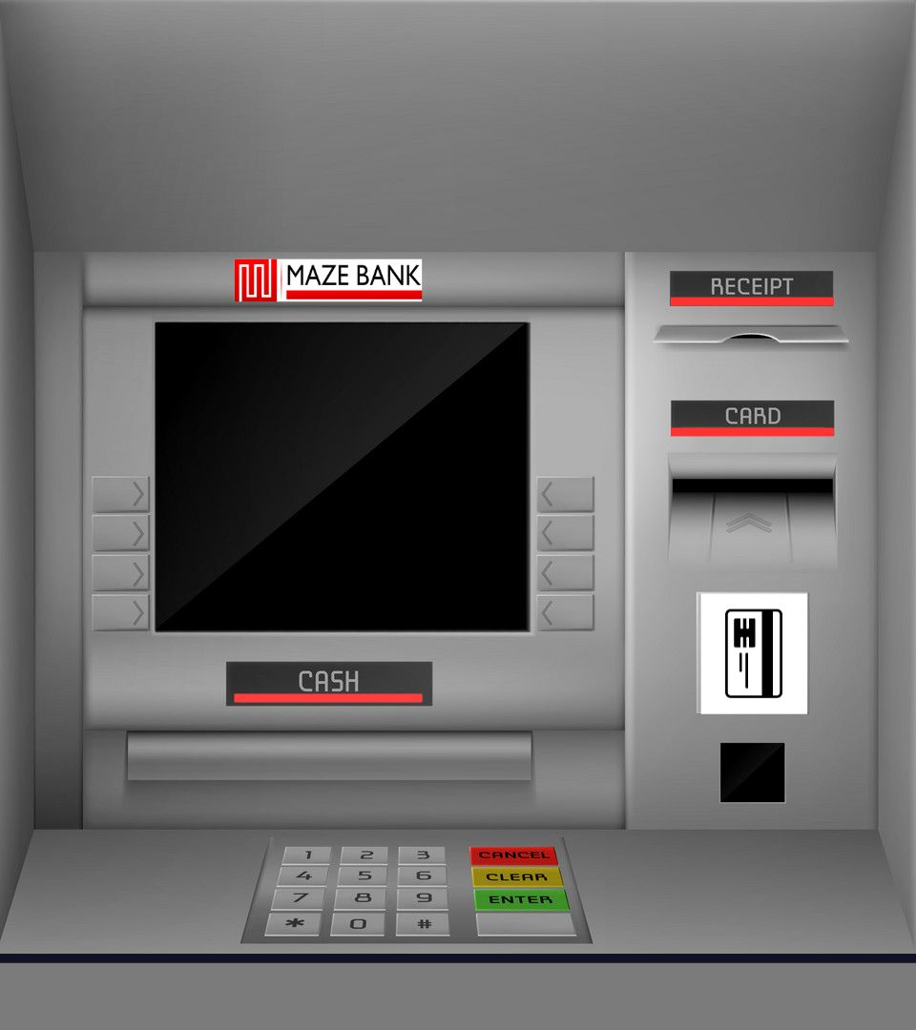
Bank Management System with ATM Interface in JAVA
Learn about the design and implementation of a robust Bank Management System with an intuitive ATM interface using JAVA, JAVA Swing and AWT.
KSHITIJ SHARMA,
Intern, VaultofCodes

Slide 2

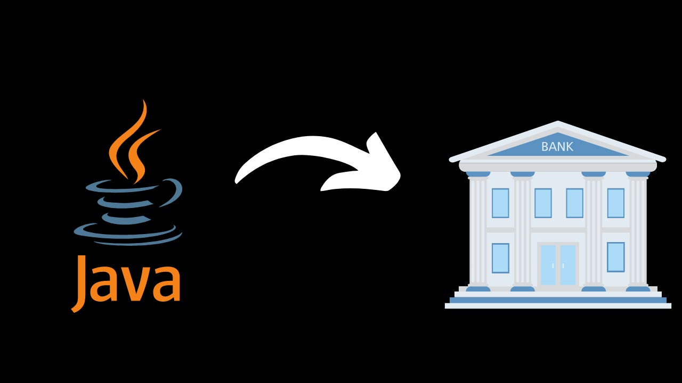
Introduction
Bank Management System is a software-based application.
This project is a model Internet Banking Application. This site enables the customers to perform the basic banking transactions by sitting at their office or at homes through PC or laptop. The system provides the access to the customer to create an account, deposit/withdraw the cash from his account, also to view reports of all accounts present. The customers can access the banks app for viewing their Account details and perform the transactions on account as per their requirements.

Slide 3
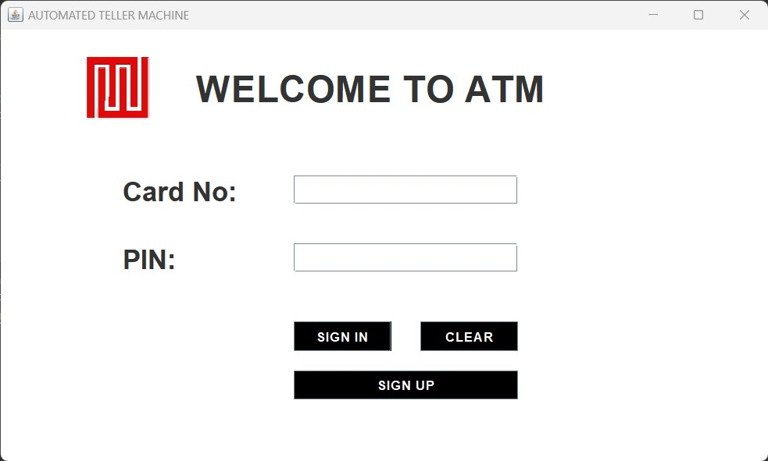
Working
Understand the inner workings of our Bank Management System with ATM interface, including real-time transaction processing, account management, and secure authentication mechanisms.
Components
1. MySQL Database :- "bms"
2. Java Files :- Named as "BalanceEnquiry", "Deposit", "conn", "FastCash", "Pin", "MiniStatement", "Signup", "Login",
"Withdrawl" and more.
3.Image icons used in java files.
4.Libraries :- MySQL java connector, JDK17, jcalendartz-1.3.3-4.
Login.java
Startup class of our project. Prompts customer to either sign in with card no. & pin OR gives signup option to create new account.

Slide 4
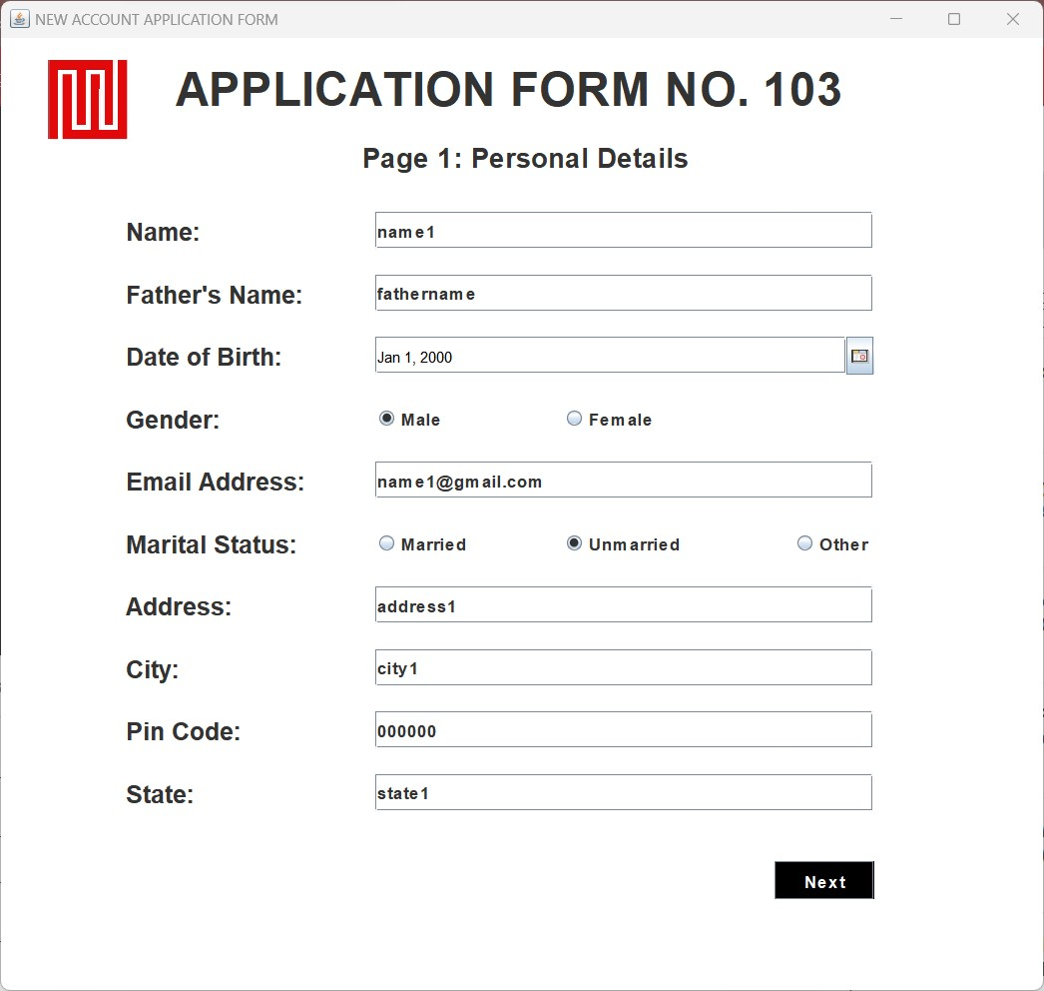
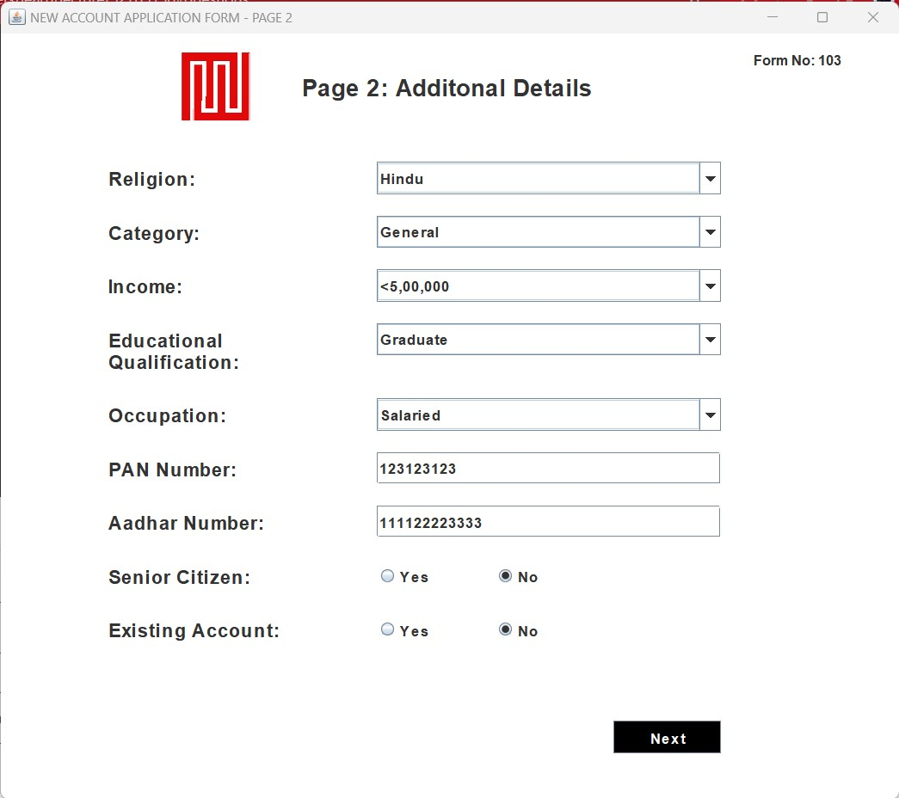
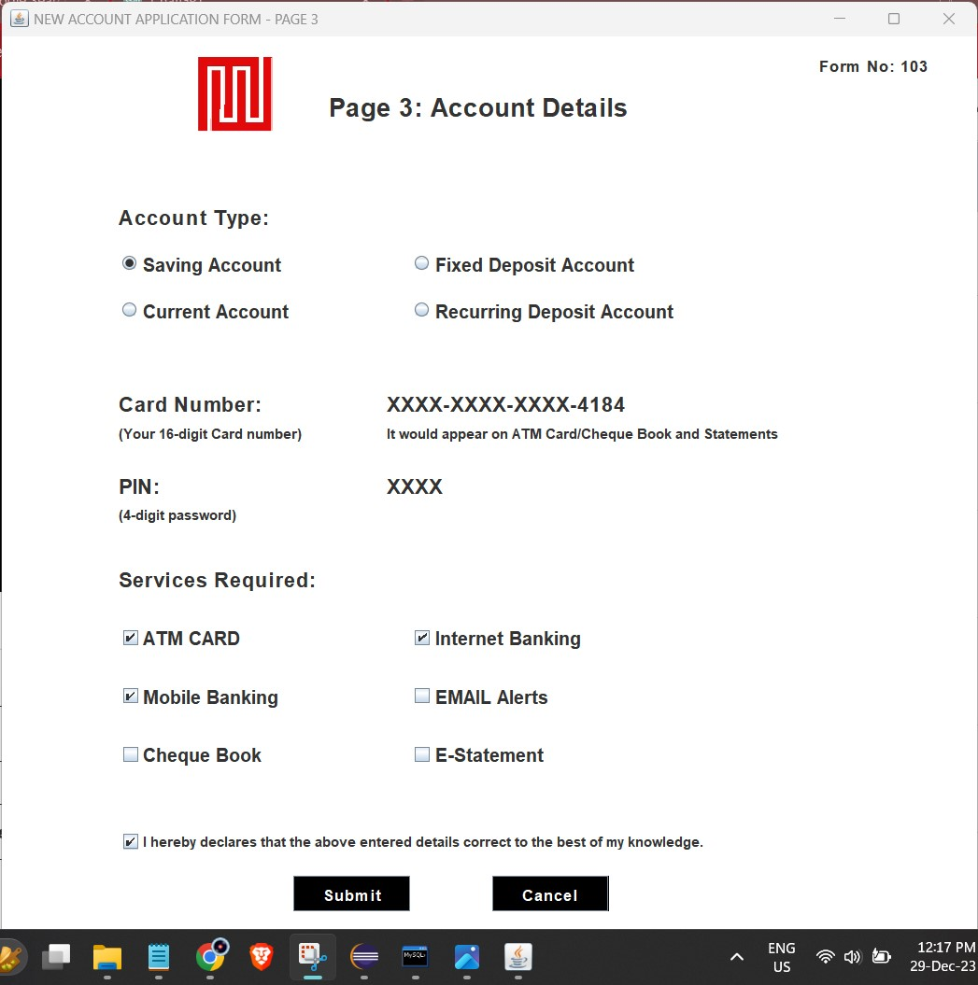
Signup.java
Signup2.java
Signup3.java
If the user chooses signup then :-
User is required to submit additional information.
User submits the last set of inputs.
The following windows shows up.

Slide 5
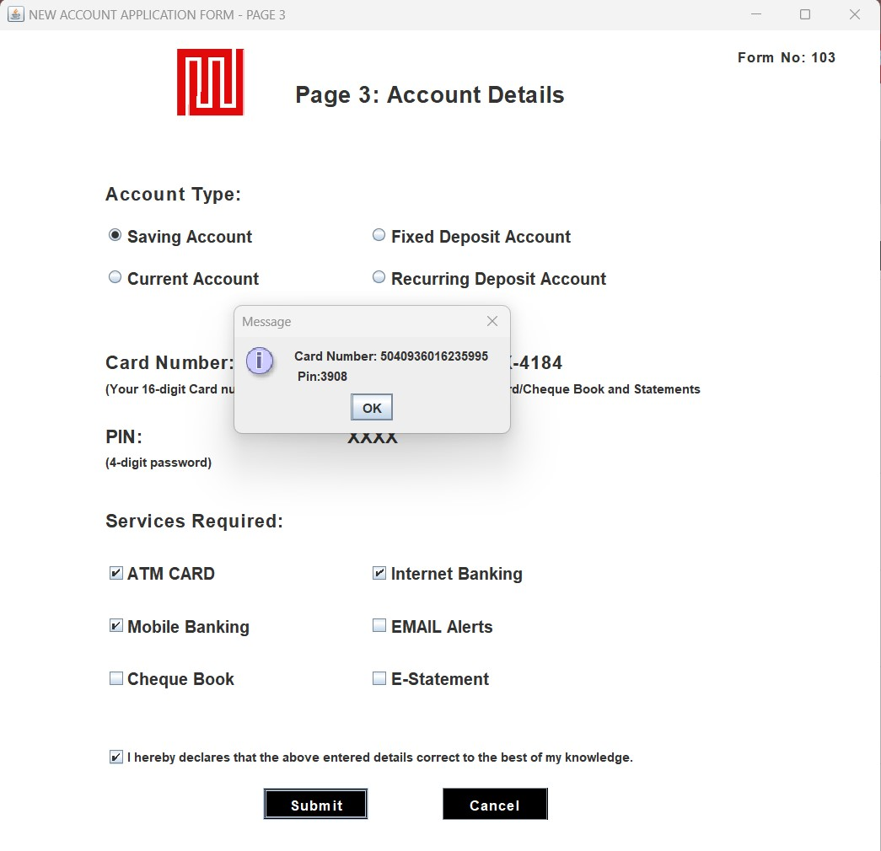
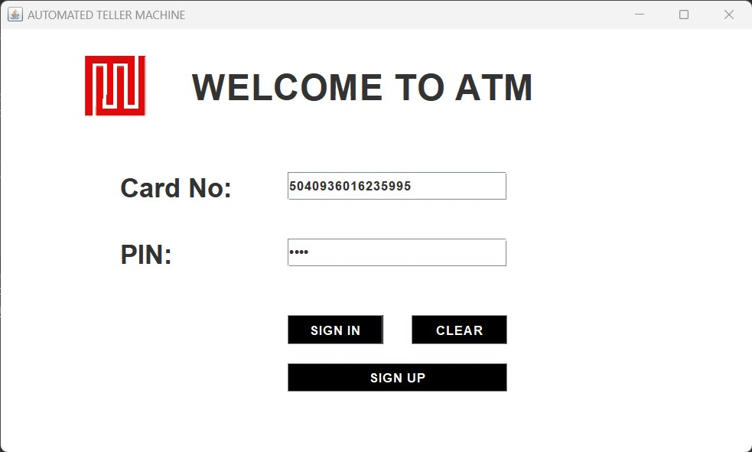
Creation of User
Card No and Pin
Login.java
If the user chooses signup then the following windows appears.
User gets the account access details in a dialog box.
This class handles the login of the user. After login then we get the our ATM interface.

Slide 6
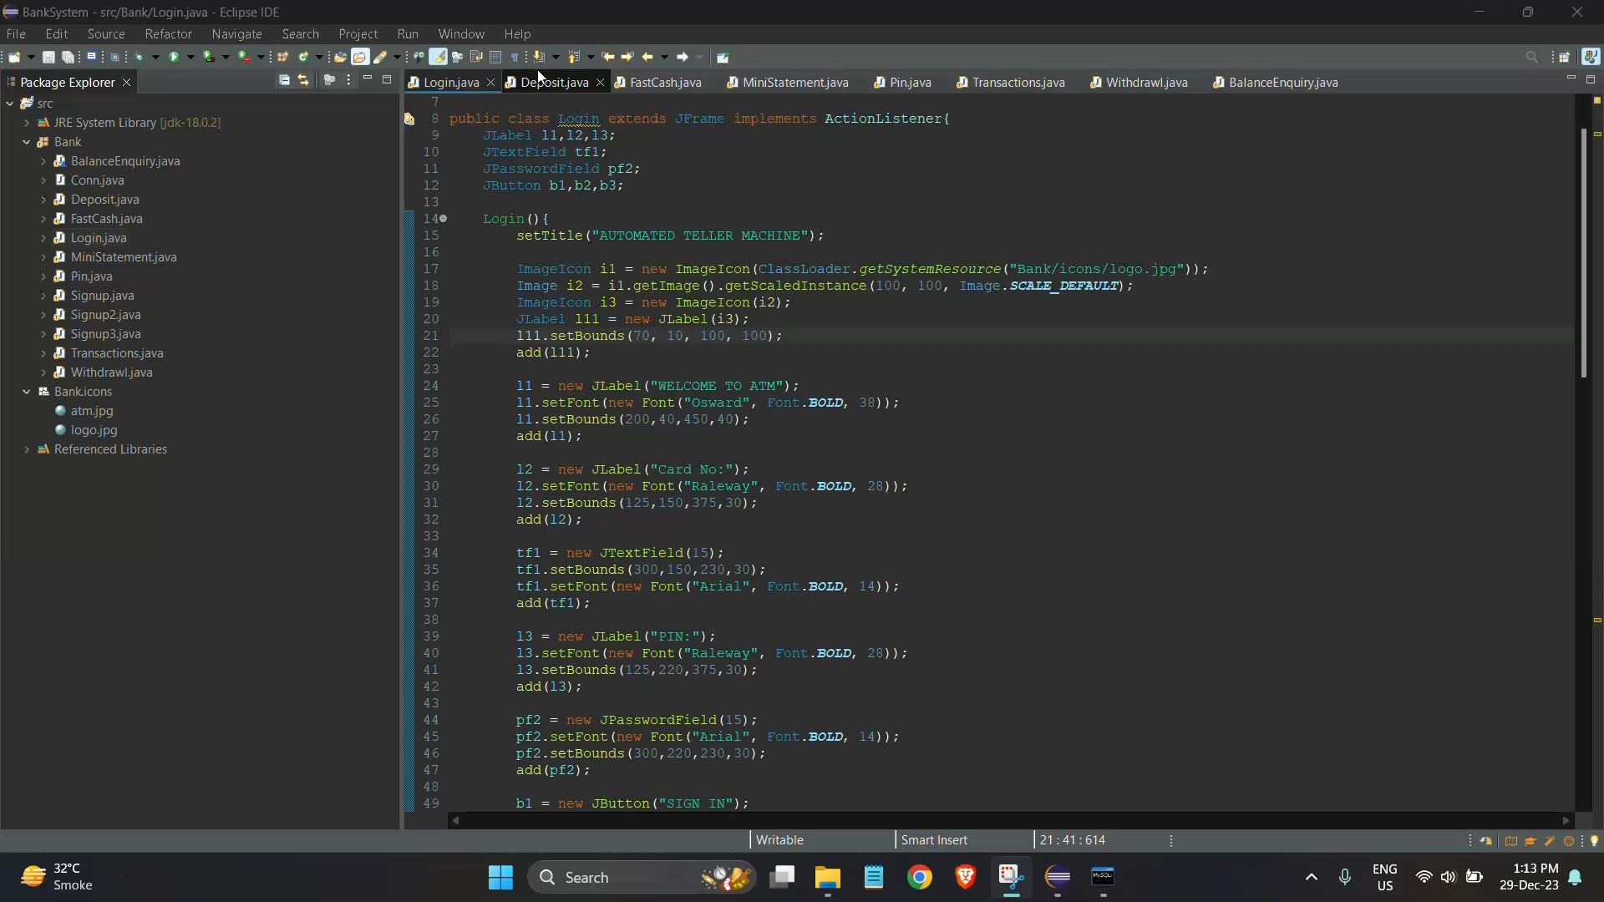
Project DEMO

Slide 7
Uses
Improved Customer Experience
Efficient Transaction Processing
Empower customers with self-service banking and quick transactions through the user-friendly ATM interface.
Ensure fast and accurate processing of various banking transactions, such as deposits, withdrawals, transfers, and balance inquiries.
Enhanced Data Security
Streamlined Operations
Protect sensitive customer information and prevent fraudulent activities with advanced encryption and authentication measures.
Optimize internal processes and reduce manual effort by automating routine tasks like account management and transaction recording.

Slide 8
Advantages & Disadvantages
Advantages
Disadvantages
Increased convenience for customers
Dependency on technology
Improved accuracy in transaction processing
Potential for system failures
Enhanced security measures
Reduced personal interaction
Efficient use of resources
Initial setup and maintenance costs

Slide 9

Future Scope
1
Advanced AI Integration
Explore the potential of integrating artificial intelligence to offer personalized banking services and predictive analytics.
2
Biometric Authentication
Implement biometric authentication methods, such as fingerprint or facial recognition, for enhanced security and convenience.
3
Support for Indian Languages
Assess the integration of various Indian and International languages to provide secure and transparent banking transactions to the customer from diverse backgrounds.

